Slide 1


DAYANANDA SAGAR COLLEGE OF ENGINEERING
(An Autonomous Institute affiliated to VTU)
Department of Computer Science and Engineering
First Year Mini Project Synopsis Presentation on
“Food Waste Reduction”
Under the Guidance of :
Prof. Muquitha Almas
Designation :
Assistant Professor
By:
Abhinav Kuri - (1ds25cS007)
Aditi vinay - (1ds25cS014)
SABEEH AHMAD - (1ds25cs219)
SATYAM jha - (1ds25cs238)

Slide 2
Agenda
Introduction
Literature survey
Problem Identification
Data Collection(field work)
Methodology and Proposed System(With Flow diagram)
References
Conclusion

Slide 3
Introduction
Food waste is a critical global issue, leading to environmental degradation, economic loss, and social imbalance.
A significant portion of edible food generated by restaurants, households, and events is discarded due to lack of timely redistribution mechanisms.
FoodLoop is a cross-platform solution (Web) designed to reduce food wastage by connecting food donors (restaurants, households, events)
The system facilitates real-time listing of surplus food, geo-location-based matching, logistics coordination, and analytics-driven monitoring
Through the integration of modern technologies such as React, Flutter, Node.js, PostreSQL, and cloud storage, FoodLoop aims to create a scalable and efficient method for minimizing food wastage.

Slide 4
Literature survey
Existing studies and platforms reveal:
Food donation apps like Feeding India & NoWaste solve logistics but lack real-time geo-matching.
Research shows 40% of food globally is wasted, while millions face hunger.
Recent systems incorporate AI, IoT, and community-driven models for waste
monitoring.
Existing solutions are fragmented; integrated donor→receiver→volunteer coordination is rare.
>> Feeding India - https://www.feedingindia.org/
>> No Waste - https://www.nowasteapp.com/

Slide 5
Problem Identification
Food wastage in restaurants, events, and households is high.
NGOs often lack visibility of available food nearby.
No unified platform connecting donors, receivers, and volunteers in real time.
Manual communication leads to delays → food expires quickly.
Lack of data analytics to measure impact or improve distribution.

Slide 6
Data Collection
Sample data collection activities:
Interviews with restaurant owners about surplus patterns
Discussions with NGOs on food pickup challenges
Observations of event food wastage
User survey on willingness to donate/request food
Findings:
Donors wanted a simple app to post food quickly
NGOs needed location-based alerts
Volunteers needed task assignment + navigation features

Slide 7
Methodology and Proposed System
FoodLoop uses a three-layer system:
1. Frontend
Web: React
2. Backend
Node.js (Express)
Auth using Firebase/Auth0
3. Database & Storage
PostgreSQL
4. Process Flow
Donor posts surplus food
Nearby receivers/volunteers notified
Claim → Pickup → Proof upload → Completion

Slide 8
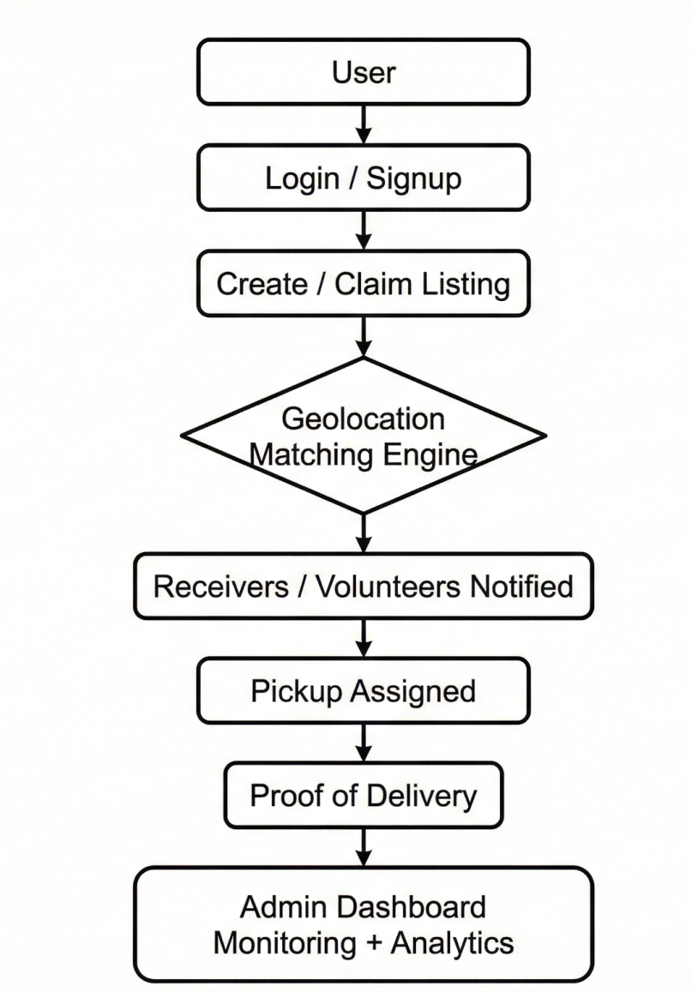
Flow diagram

Slide 9
References
Understanding food waste reducing platforms: A mini-review (2023)
>> https://pmc.ncbi.nlm.nih.gov/articles/PMC10108325/
Measuring the Effects of an Anti-Food-Waste Digital Application from the Operators' Perspective
>> https://www.mdpi.com/2413-8851/8/2/57
Digital Technologies in Food Supply Chain Waste Management (Case Study on Smart Cities)
>> https://www.mdpi.com/2071-1050/17/5/1996
Exploring the potential of AI-driven food waste management strategies used in the hospitality industry for application in household settings
>> https://pmc.ncbi.nlm.nih.gov/articles/PMC11799730/

Slide 10
Conclusion
Overview
A scalable, data-driven web solution designed to minimize food wastage through efficient redistribution and community engagement.
Key Advantages
Efficiency: Real-time listings with geo-location matching and automated expiry.
Impact: Built-in analytics to track meals saved and CO2 reduction.
Trust: Secure workflows with proof of pickup (photo/signature) and role verification.
Core Applications
Donation Management: Streamlines surplus offloading for restaurants, households, and events.
Logistics Network: Connects NGOs and volunteers for rapid claim and transport.
Future Roadmap
Expansion: Development of a dedicated Mobile App.
Communication: Integration of in-app Chat & Notification systems.

Slide 11
Thank You

